Slide 1
Elements of the WIMP Interface
HCI
Presenter
  Kimani, Stephen
  SCIT
  JKUAT
Notes:
Opening Slide

Slide 2
Elements of the WIMP Interface
HCI
Roadmap
Introduction
WIMP elements
Other widgets*
* Widgets are interaction elements/objects/gadgets
Notes:
Opening Slide

Slide 3
HCI
Elements of the WIMP Interface
Introduction
Interaction styles:
Command line interface
Menus
Natural language
Form-fills and spreadsheets
WIMP
  The most common of the above interaction styles is WIMP
WIMP:
Acronym for
Windows, Icons, Menus and Pointers or
Windows, Icons, Mice and Pull-down menus
Examples of WIMP interfaces: MS Windows for PCs, MacOs for Apple Macintosh, various X Windows-based systems for UNIX
Notes:
Introduction

Slide 4
HCI
Elements of the WIMP Interface
WIMP Elements
Windows
Windows are areas of the screen that behave as if they were independent terminals
They can contain text and/or graphics
They can be moved, resized, closed
Many windows can be displayed on the screen simultaneously thereby allowing multiple separated tasks to be visible at the same time. The user can switch from one from one task to another by moving from one window to another
Windows can overlap and obscure each other. To address that problem, windows can be laid out next to one another (tiled) [see next slide] or windows can be arranged such that each window is placed slightly to the left or right and below or above the other window (cascaded) [see next slide]
Notes:
Introduction

Slide 5
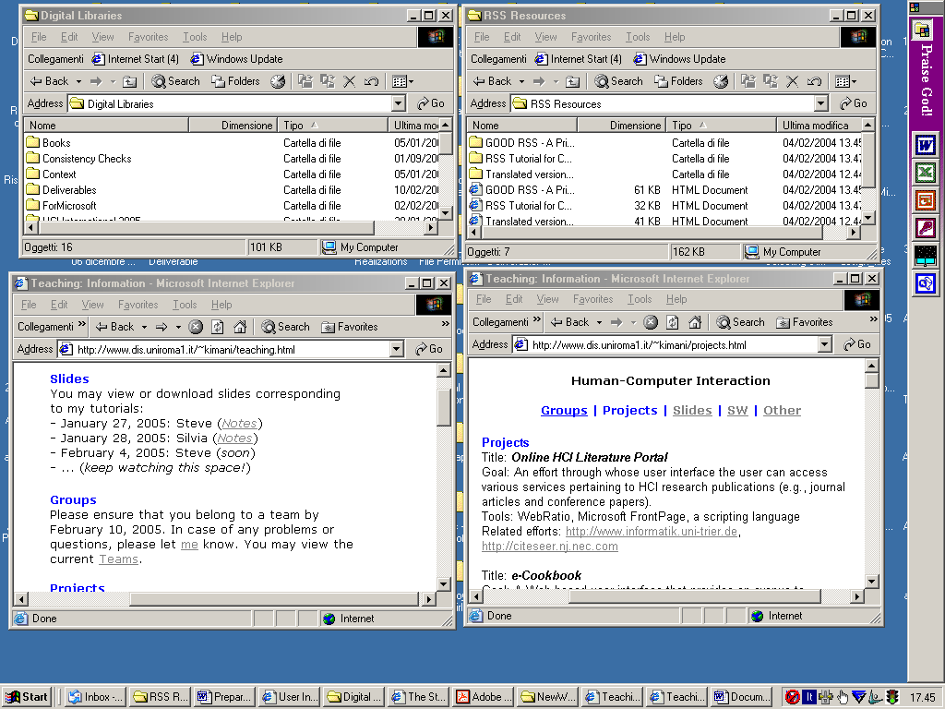
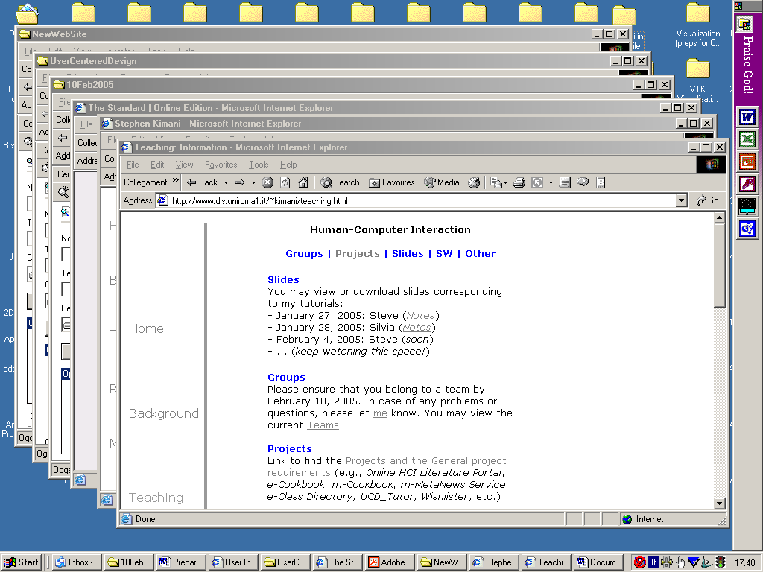
HCI
Elements of the WIMP Interface
WIMP Elements
Windows: Tiled Windows: Cascaded
Notes:
Introduction

Slide 6
HCI
Elements of the WIMP Interface
WIMP Elements
Windows
Scrollbars - enable users to move the contents of the window up and down (vertical scrollbar), or from side to side (horizontal scrollbar).
Title bars - describe the name of the window
Status bar-status of the task/process in the window
When multiple windows are displayed on the screen at the same time, the active window is usually distinguished by a shaded/bold title bar.
Usually there are also some boxes/widgets for resizing and closing the window
Some systems support windows within windows eg in Microsoft Powerpoint (MS Office 2000)
Notes:
Introduction

Slide 7
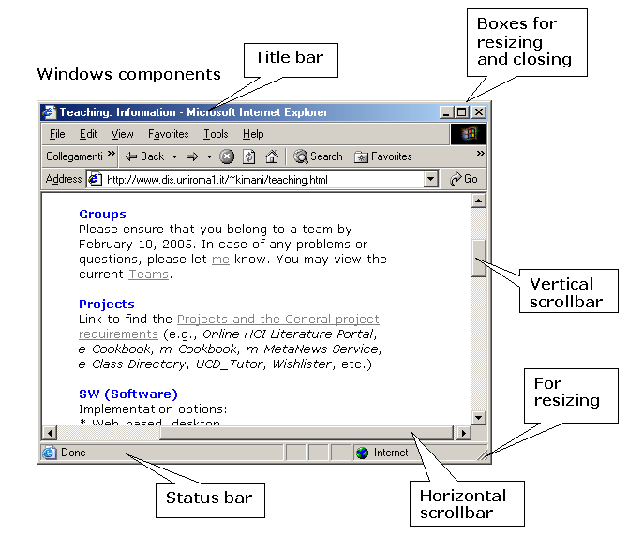
HCI
Elements of the WIMP Interface
WIMP Elements
Notes:
Introduction

Slide 8
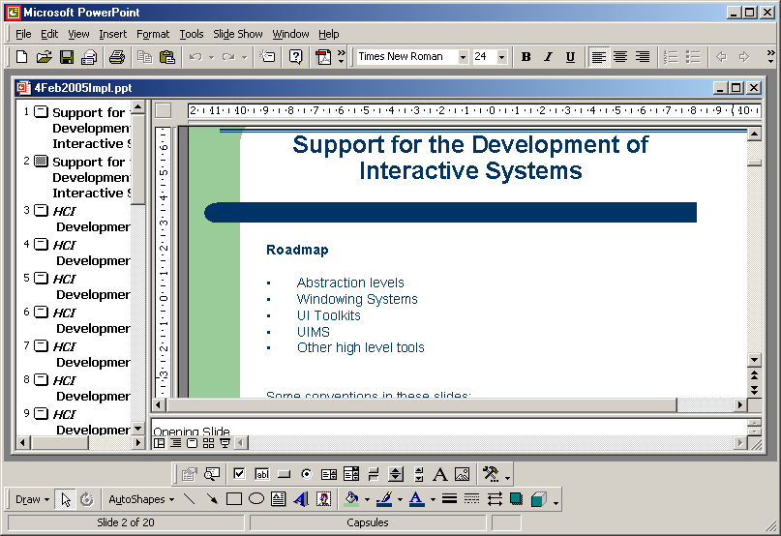
HCI
Elements of the WIMP Interface
WIMP Elements
Windows
Some systems support windows within windows eg Powerpoint (Office 2000)
Notes:
Introduction

Slide 9
HCI
Elements of the WIMP Interface
WIMP Elements
Icons
An icon is a small picture or image, used to represent some aspect of the system (e.g., folders for holding files, wastebasket for throwing unwanted/deleted files) or to represent some other object in the interface (e.g., a window).
Windows can be closed down to this small representation (iconized) - icons therefore:
  save screen space and therefore a lot of windows can be available on the screen simultaneously
  are a reminder to the user that s/he can resume dialog (or interaction with the represented application) by simply opening up the window.
Icons can take many forms: highly realistic, abstract, etc
Notes:
Introduction

Slide 10
HCI
Elements of the WIMP Interface
WIMP Elements
Pointers
Pointers are important because interaction in WIMP interfaces relies a lot on pointing and selecting interaction objects such as icons and menu items
The mouse is the most common device for pointing and clicking.
However, other input devices such as joystick, trackball, cursor keys or keyboard shortcuts too can be used for such tasks i.e., pointing and selecting
The user is presented with a pointer (a cursor on the screen) - the cursor is controlled by the input device
Pointers can bear many forms e.g.,
In a particular system, different cursors are used to represent different modes/states e.g., normal cursor as an arrow, double-arrowed cursor for resizing windows, hour-glass when system is busy, etc
A hot-spot is the location to which the cursor points. The hot-spot of the cursor should be obvious to the user
Notes:
Introduction

Slide 11
HCI
Elements of the WIMP Interface
WIMP Elements
Menus
An interaction feature that presents a choice of operations or services [on the screen] that can be performed by the system at a given time
The human being's ability to recognize information [given a visual cue] is superior to his/her ability to recall the information. Menus can serve as cues for the operations or services that the system can perform. Therefore, the labels/names used for the commands in menus should be informative and meaningful
A potential candidate for selection can be indicated by using a pointing device (eg mouse, arrow keys, etc) to move the pointer accordingly. As the pointer moves, the menu item is usually highlighted. Selection of a menu item can be realized by some additional user action (eg pressing a button on the pointing devices, pressing some key on the keyboard, etc)
Notes:
Introduction

Slide 12
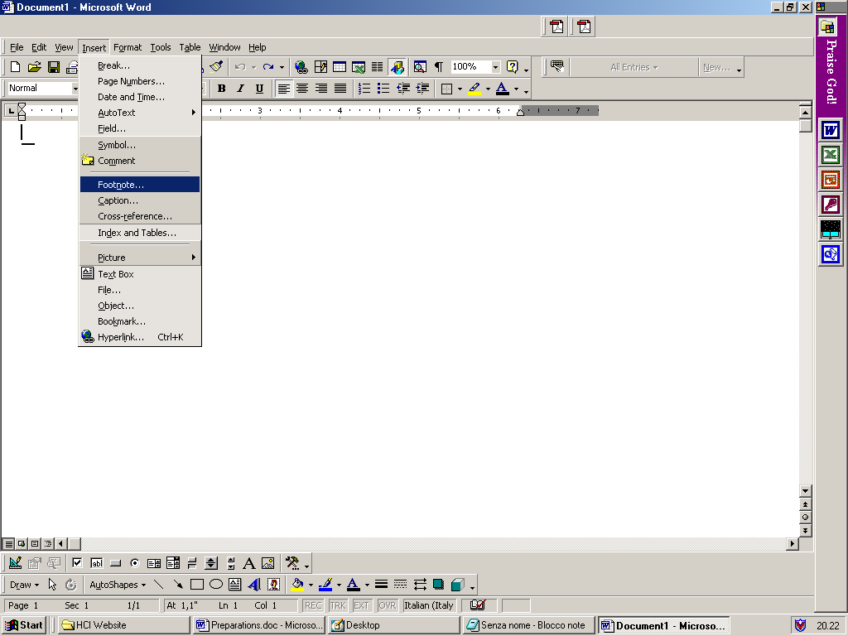
HCI
Elements of the WIMP Interface
WIMP Elements
Menus
Notes:
Introduction

Slide 13
HCI
Elements of the WIMP Interface
WIMP Elements
Menus
When there are too many items, the menu items are often grouped and layered. The main menu, usually represented as a menu bar, should be conspicuous or readily available/accessible. Menu bars are often placed at one of the sides of the screen or window. For instance: at the top of the screen (eg MacOS), at the top of each window (eg Microsoft Windows). There are various types of menus [NB: a-d can save screen space]:
Pull-down menus - they are dragged from the main menu by moving the pointer into the menu bar and pressing the button
Fall-down menus - they automatically appear from the main menu when the pointer enters the menu bar, without having to press the button.
Pop-up menus - they appear when a particular region of the screen, maybe designated by an icon, is selected, but they only stay as long as the [mouse] button is depressed (remains pressed down without releasing)
Pin-up menus - they can be 'pinned'/attached to the screen, staying in place until explicitly asked to go away
Pie menus - the menu options have a circular arrangement with the pointer at the center
Notes:
Introduction

Slide 14
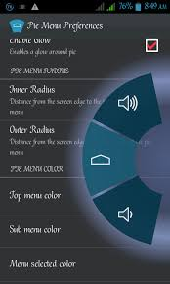
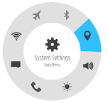
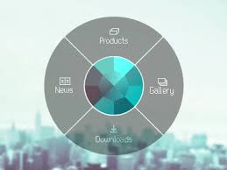

HCI
Elements of the WIMP Interface
WIMP Elements
Menus
Pie menus' advantages:
  it is easier to select items, since they each can have a large target area
  the selection time for each item is the same, since the pointer is equidistant from each of them
Pie menus' disadvantage:
  they take up more screen space
Pie-menu examples
Notes:
Introduction

Slide 15
HCI
Elements of the WIMP Interface
WIMP Elements
Menus
The challenge with menus in general:
  deciding which items to include
  how to group those items
Some guidelines on menu design:
  a menu label in pull-down menus should reflect the functions of the underlying menu items
  the items in pull-down menus should be grouped by function
  menu groupings in pull-down menus should be consistent (to facilitate the transfer of learning and confidence to the user)
  menu items should be ordered in the menu according to some measure of importance (eg frequency of use)
  opposite functionalities (e.g., 'save' and 'delete') should be kept apart to prevent accidental selection of the wrong function
Notes:
Introduction

Slide 16
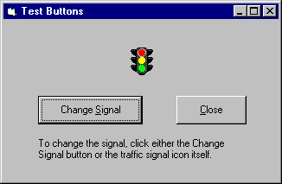
HCI
Elements of the WIMP Interface
Other Widgets
Buttons
Buttons are individual and isolated regions within a display that can be selected to invoke specific operations
The meaning of the underlying operation is usually indicated by a textual label and/or a small icon on the button
Example of command buttons:
Notes:
Introduction

Slide 17
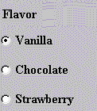
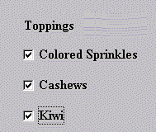
HCI
Elements of the WIMP Interface
Other Widgets
Buttons
Buttons can also be used to toggle between states to display status information (eg to indicate whether the text is italicized or not in a word processor) or to select options (as in a form)
Radio buttons enable the user to select one feature from a set of mutually exclusive options
Check boxes enable the user to select one or more features from a set of options that is not mutually exclusive
Example of radio buttons Example of check boxes
Notes:
Introduction

Slide 18
HCI
Elements of the WIMP Interface
Other Widgets
Toolbars
A toolbar is a collection of small buttons, each with icons, providing commonly used functions
Note that although a toolbar's function is similar to that of a menu bar, toolbar's icons are smaller than the equivalent text - therefore more functions can be simultaneously displayed
In some cases a toolbar can be customized whereas in other cases a toolbar is fixed
Example: for Microsoft Windows applications
Notes:
Introduction

Slide 19
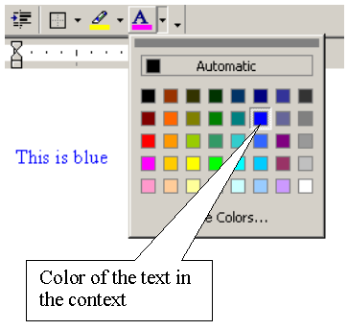
HCI
Elements of the WIMP Interface
Other Widgets
Palettes
A palette is a mechanism for making the set of possible modes and the active/current mode visible to the user
It is usually a collection of icons that are reminiscent of the purpose of the various modes
Example on the right: A color palette in MS Word
Some systems allow users to create palettes from menus or toolbars (or to customize palettes)
Notes:
Introduction

Slide 20
HCI
Elements of the WIMP Interface
Other Widgets
Dialog boxes
A dialog box is an information window used by the system to bring the user's attention to some important event (e.g., an error or warning) or to invoke a subdialog between the user and the system for a very specific task that is part of a larger task (e.g., a dialog for saving a file)
Notes:
Introduction

Slide 21
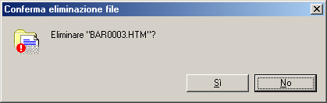
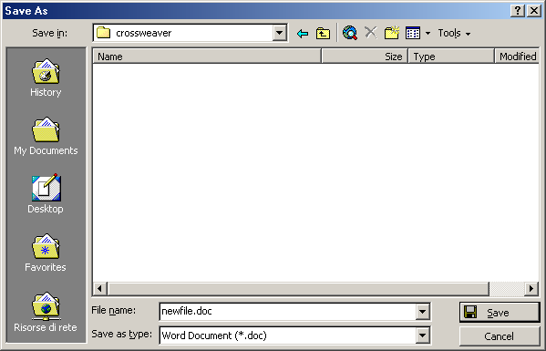
HCI
Elements of the WIMP Interface
Other Widgets
Dialog boxes
Example: Warning Example: Saving a file
Notes:
Introduction

Slide 22
Elements of the WIMP Interface
HCI
Thanks
&
Questions
Notes:
Opening Slide

